Slide 1
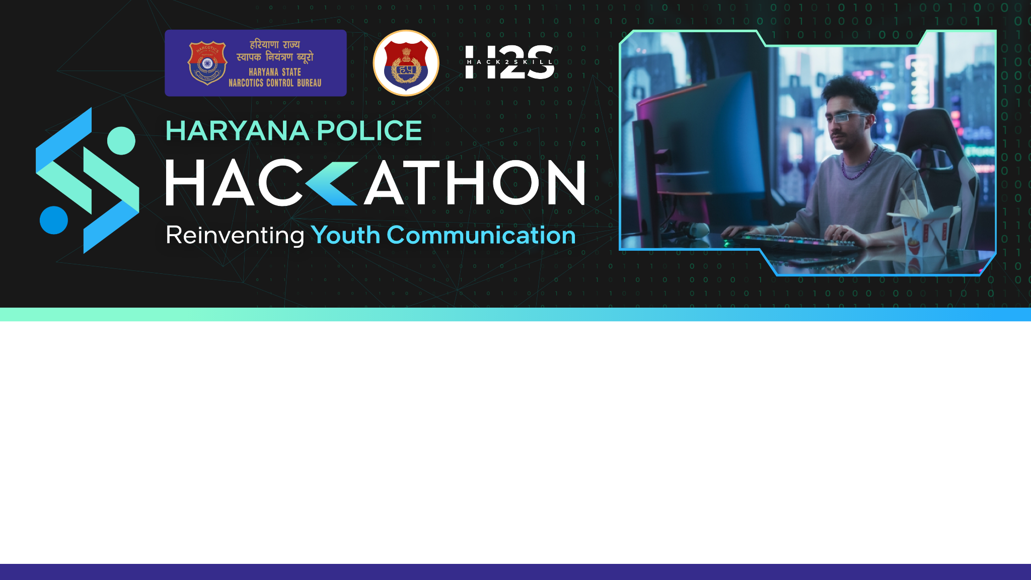
Team Name: Team Four
Team Members Names: Athavan K , Sai Siddharth P , Harish M ,Arshath Parves I
Problem Statement: Cracking the Code to Youth Engagement
College/Organisation Name: Chennai Institute of technology

Slide 2

Problem Statement Understanding :Cracking the Code to Youth Engagement
The challenge is to effectively communicate anti-drug and delinquency messages to today's hyper-connected youth without resorting to traditional, ineffective methods.
The objective is to engage young minds through cutting-edge strategies that leverage mobile apps, social media, and other information and communication technologies (ICTs).
The conventional approach of boring lectures is to be replaced with a multifaceted plan, incorporating elements such as a gamified mobile app, influencer-driven social media campaigns, augmented and virtual reality experiences, educational podcasts, an AI-powered chatbot, and community challenges.
The aim is to immerse the youth in a positive online environment, using creative and interactive means to convey the importance of making positive life choices and avoiding drugs and delinquency.

Slide 3
Brief about the Idea/Prototype
The proposed solution is a comprehensive and innovative initiative called "PositiveVibes360." It includes the development of a gamified mobile app, "LifeCrafters," offering users an interactive platform to navigate real-life scenarios related to drug prevention.
Simultaneously, the #PositiveVibesChallenge on social media, spearheaded by influencers, encourages users to share positive experiences and challenges related to making healthy life choices. Augmented reality app, "RealityCheck," overlays drug-related information on real-world locations, while the "SoundMind" podcast series features influential figures discussing mental health and self-improvement.
Virtual reality workshops, "FutureForge," allow users to explore drug-free futures, and an AI-powered chatbot, "ChatGuard," offers support. "ImpactHub" hosts monthly community challenges with rewards. This multifaceted approach saturates digital spaces with positive content, fostering a supportive online community to effectively capture and sustain the attention of today's youth.

Slide 4
Proposed Solutions
The proposed solution involves a multifaceted approach named "PositiveVibes360" to effectively communicate anti-drug and delinquency messages to today's hyper-connected youth.
This includes the development of "LifeCrafters," a gamified mobile app that engages users in navigating real-life scenarios. The #PositiveVibesChallenge on social media, driven by influencers, encourages the sharing of positive experiences. An augmented reality app, "RealityCheck," overlays drug-related information onto real-world locations, enhancing awareness.
The "SoundMind" podcast series provides educational content, while "FutureForge" offers virtual reality workshops to explore drug-free futures. An AI-powered chatbot, "ChatGuard," ensures accessible support. Monthly community challenges through "ImpactHub" incentivize positive actions. This holistic strategy leverages cutting-edge technologies, influencers, and community engagement to saturate digital spaces with positive messaging, fostering a supportive online environment that resonates with and captures the attention of today's youth.

Slide 5
Architecture/Flow diagram of solution

Slide 6
Tech Stack used
Mobile App (LifeCrafters)
Influencer-Driven Social Media Campaign (#PositiveVibesChallenge)
Augmented Reality App (RealityCheck)
Educational Podcast Series (SoundMind)
Virtual Reality Workshops (FutureForge)
AI-Powered Chatbot (ChatGuard)
Community Challenges and Rewards (ImpactHub)

Slide 7
GitHub Repository Link of the prototype

Slide 8
Demo video link

Slide 9
